Slide 1

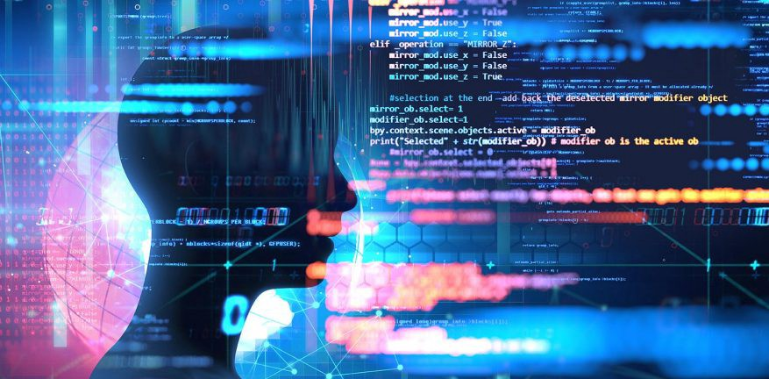
MCSE0007: Machine Learning
Class Presentations on Machine Learning by Prof. Anand Singh Jalal

Slide 2
Syllabus: Module - 1
Introduction: Machine Learning basics, Applications, Type of Learning Algorithm
Machine Learning : Training, Testing, Evaluation: Cross-validation, Confusion Matrix, Precision, Recall, F1-score, ROC curve, Under fitting, Over fitting, Bias Variance Trade off
Supervised Learning: Regression- Linear regression, Polynomial regression, Gradient Descent Algorithm
Data Preprocessing: Imputation, Outlier management, One hot encoding, Feature selection, Filter and Wrapper approach
Dimensionality Reduction: Feature selection vs feature extraction
Supervised Learning: Classification- Logistic regression, k-nearest neighbor classifier, Decision tree classifier, Naïve Bayes classifier

Slide 3
Syllabus: Module - 2
Supervised Learning: Support vector machine classifier
Feature Extraction: Principal Component Analysis (PCA)
Unsupervised Learning: k-means clustering, Hierarchical clustering
Ensemble methods: Bagging, Boosting, Improving classification with Random forest, Ada-Boost algorithm.
Artificial Neural Network : - Introduction, Model Representation, Gradient Descent, Stochastic Gradient Descent, Multilayer Perceptron, Multiclass Representation, Back propagation Algorithm.
Deep Learning: Introduction, Convolutional neural network

Slide 4
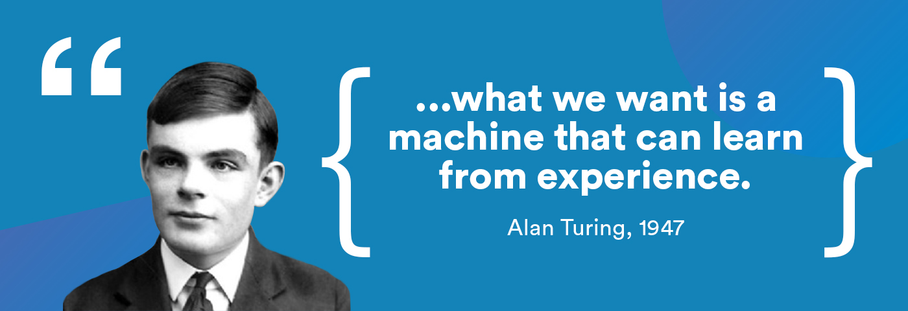
Few Quotes

Slide 5
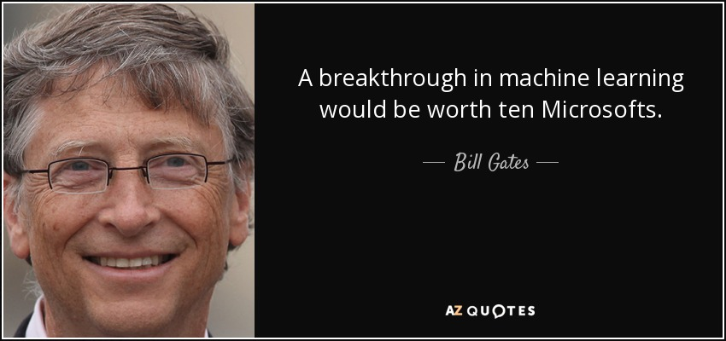
Few Quotes …

Slide 6
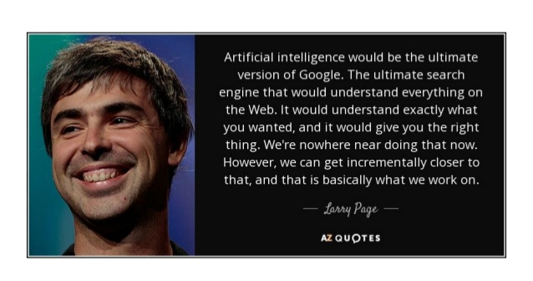
Few Quotes …

Slide 7
Data Everywhere!

Slide 8
Data Types

Slide 9
We are “DATAFIED”

Slide 10
Data Science Process
Notes:
exploratory data analysis (EDA)

Slide 11
Sample Applications
Spam filtering
Credit card fraud detection
Digit recognition on checks, zip codes
Detecting faces in images
MRI image analysis
Recommendation system
Search engines
Handwriting recognition
Scene classification
etc...
Notes:
What is machine learning? You probably use it dozens of times a day without even knowing it. Each time you do a web search on Google or Bing, that works so well because their machine learning software has figured out how to rank what pages. When Facebook or Apple's photo application recognizes your friends in your pictures, that's also machine learning. Each time you read your email and a spam filter saves you from having to wade through tons of spam, again, that's because your computer has learned to distinguish spam from non-spam email. So, that's machine learning. There's a science of getting computers to learn without being explicitly programmed. One of the research projects that I'm working on is getting robots to tidy up the house. How do you go about doing that? Well what you can do is have the robot watch you demonstrate the task and learn from that. The robot can then watch what objects you pick up and where to put them and try to do the same thing even when you aren't there. For me, one of the reasons I'm excited about this is the AI, or artificial intelligence problem. Building truly intelligent machines, we can do just about anything that you or I can do. Many scientists think the best way to make progress on this is through learning algorithms called neural networks, which mimic how the human brain works,

Slide 12
Traditional Programming Vs Machine Learning
Traditional Programming
Input (Data)
Computer
Output
Program
Machine Learning
Input Data
Computer
Program
Output

Slide 13
What Is Machine Learning?
"the field of study that gives computers the ability to learn without being explicitly programmed." - Arthur Samuel (1959)
"A computer program is said to learn from experience E with respect to some class of tasks T and performance measure P, if its performance at tasks in T, as measured by P, improves with experience E." - Tom Mitchell (1997)
Notes:
Example: playing checkers.
E = the experience of playing many games of checkers
T = the task of playing checkers.
P = the probability that the program will win the next game.
In general, any machine learning problem can be assigned to one of two broad classifications:
supervised learning, OR unsupervised learning.
Example: Marks in Exam, diagnostic the patient

Slide 14
What Is Machine Learning?
Machine learning is about predicting the future based on the past.
-- Hal Daume III
past
future
predict
learn
Training
Data
model/
predictor
Testing
Data
model/
predictor

Slide 15

Suppose your email program watches which emails you do or do not mark as spam, and based on that learns how to better filter spam. What is the task T in this setting?
Classify emails as spam or not spam.
Watching you label emails as spam or not spam.
The number (or fraction) of emails correctly classified as spam/not spam.
Notes:
Classify emails as spam or not spam. - T
Watching you label emails as spam or not spam. - E
The number (or fraction) of emails correctly classified as spam/not spam. - P

Slide 16
ML in a Nutshell
Tens of thousands of machine learning algorithms
Hundreds new every year
Every machine learning algorithm has three components:
Representation
Evaluation
Optimization

Slide 17
Representation
Decision trees
Sets of rules / Logic programs
Instances
Graphical models (Bayes/Markov nets)
Neural networks
Support vector machines
Model ensembles
Etc.

Slide 18
Evaluation
Accuracy
Precision and recall
Squared error
Likelihood
Posterior probability
Cost / Utility
Margin
Entropy
K-L divergence
Etc.

Slide 19
Optimization
Combinatorial optimization
E.g.: Greedy search
Convex optimization
E.g.: Gradient descent
Constrained optimization
E.g.: Linear programming

Slide 20
Types of Learning
Supervised (inductive) learning
Training data includes desired outputs
Unsupervised learning
Training data does not include desired outputs
Semi-supervised learning
Training data includes a few desired outputs
Reinforcement learning
Rewards from sequence of actions

Slide 21
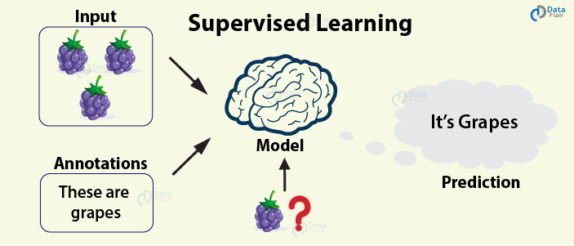

Slide 22
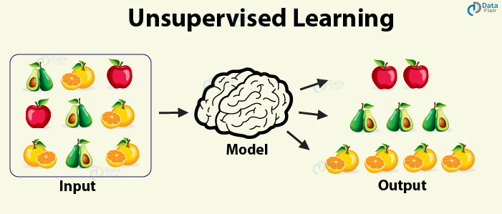

Slide 23
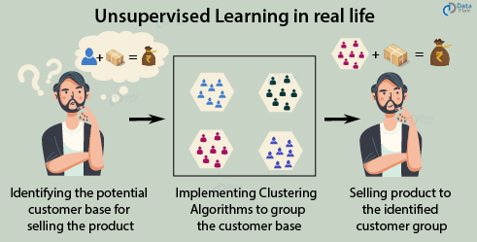

Slide 24
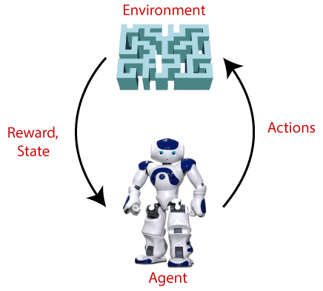
Reinforcement learning

Slide 25
Learning Approaches
Supervised Learning
Unsupervised Learning
The training data is annotated with information to help the learning system
The training data is not annotated with any extra information to help the learning system

Slide 26
Inductive Learning
Given examples of a function (X, F(X))
Predict function F(X) for new examples X
Discrete F(X): Classification
Continuous F(X): Regression
F(X) = Probability(X): Probability estimation

Slide 27

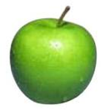
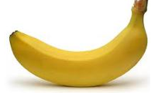
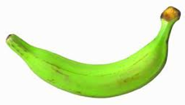
Data
examples
Data

Slide 28

Data…
examples
Data

Slide 29
Supervised learning
examples
label
label₁
label₃
labeled examples
label₄
label₅
Supervised learning: given labeled examples

Slide 30
Supervised learning …
label
label₁
model/
predictor
label₃
label₄
label₅
Supervised learning: given labeled examples

Slide 31
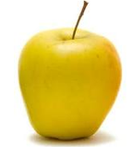
Supervised learning …
model/
predictor
predicted label
Supervised learning: learn to predict new example

Slide 32
Supervised learning: classification
label
apple
Classification: a finite set of labels
apple
banana
banana
Supervised learning: given labeled examples

Slide 33
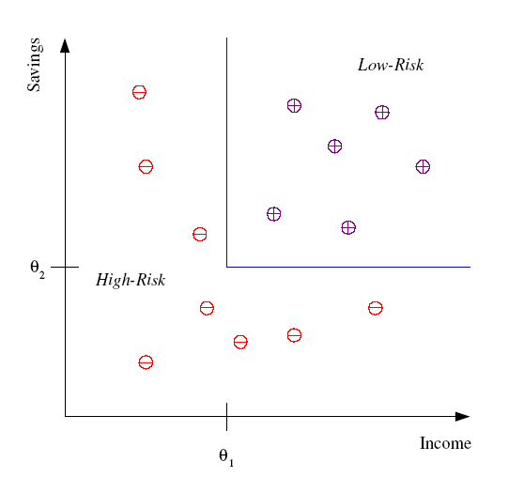
Classification Example
Differentiate between low-risk and high-risk customers from their income and savings

Slide 34
Classification Applications
Face recognition
Character recognition
Spam detection
Medical diagnosis: From symptoms to illnesses
Biometrics: Recognition/authentication using physical and/or behavioral characteristics: Face, iris, signature, etc
...

Slide 35
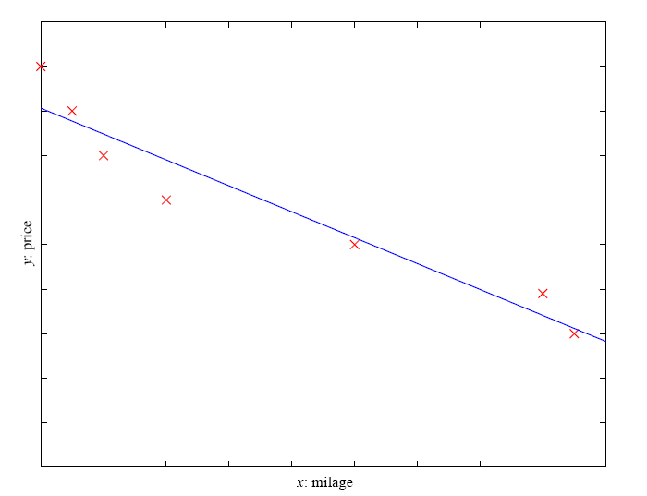
Supervised Learning: Regression
Price of a used car
x : car attributes (e.g. mileage)
y : price
y = wx+w₀
Regression: label is real-valued

Slide 36

You’re running a company, and you want to develop learning algorithms to address each of two problems.
Problem 1: You have a large inventory of identical items. You want to predict how many of these items will sell over the next 3 months.
Problem 2: You’d like software to examine individual customer accounts, and for each account decide if it has been hacked/compromised.
Should you treat these as classification or as regression problems?
Notes:
Problem 1 – Regression
Problem 2 - Classification

Slide 37
Should you treat these as classification or as regression problems?
Treat both as classification problems.
Treat problem 1 as a classification problem, problem 2 as a regression problem.
Treat problem 1 as a regression problem, problem 2 as a classification problem.
Treat both as regression problems
Notes:
Ans 3

Slide 38
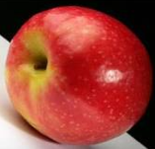
Unsupervised learning
Unupervised learning: given data, i.e. examples, but no labels

Slide 39
Unsupervised learning …
Methods: K-means, gaussian mixtures, hierarchical clustering, spectral clustering, etc.

Slide 40
Unsupervised learning …
Social network analysis
Astronomical data analysis
Market segmentation

Slide 41
Unsupervised learning …
Learning “what normally happens”
No output
Clustering: Grouping similar instances
Other applications: Summarization, Association Analysis
Example applications
Customer segmentation in CRM
Image compression: Color quantization
Bioinformatics: Learning motifs

Slide 42
Of the following examples, which would you address using an unsupervised learning algorithm? (Mark all that apply.)
Given email labeled as spam/not spam, learn a spam filter.
Given a set of news articles found on the web, group them into set of articles about the same story.
Given a database of customer data, automatically discover market segments and group customers into different market segments.
Given a dataset of patients diagnosed as either having diabetes or not, learn to classify new patients as having diabetes or not.
Notes:
Ans 2, 3

Slide 43
Supervised Vs Unsupervised

Slide 44
Supervised Vs Unsupervised

Slide 45
Reinforcement learning
left, right, straight, left, left, left, straight
GOOD
left, straight, straight, left, right, straight, straight
BAD
left, right, straight, left, left, left, straight
18.5
left, straight, straight, left, right, straight, straight
-3
Given a sequence of examples/states and a reward after completing that sequence, learn to predict the action to take in for an individual example/state

Slide 46
Reinforcement learning …
Topics:
Policies: what actions should an agent take in a particular situation
Utility estimation: how good is a state (→used by policy)
No supervised output but delayed reward
Credit assignment problem (what was responsible for the outcome)
Applications:
Game playing
Robot in a maze
Multiple agents, partial observability, ...

Slide 47
A computer program is said to learn from experience E with respect to some task T and some performance measure P if its performance on T, as measured by P, improves with experience E. Suppose we feed a learning algorithm a lot of historical weather data, and have it learn to predict weather. In this setting, what is T?
None of these.
The process of the algorithm examining a large amount of historical weather data.
The probability of it correctly predicting a future date's weather.
The weather prediction task.
Notes:
Ans: 4

Slide 48
Suppose you are working on weather prediction, and you would like to predict whether or not it will be raining at 5pm tomorrow. You want to use a learning algorithm for this.
Would you treat this as a classification or a regression problem?
Regression
Classification
Notes:
Answer:
Classification

Slide 49
Suppose you are working on stock market prediction. You would like to predict whether or not a certain company will declare bankruptcy within the next 7 days (by training on data of similar companies that had previously been at risk of bankruptcy). Would you treat this as a classification or a regression problem?
Classification
Regression
Notes:
Answer:
Classification

Slide 50
Some of the problems below are best addressed using a supervised learning algorithm, and the others with an unsupervised learning algorithm. Which of the following would you apply supervised learning to? (Select all that apply.) In each case, assume some appropriate dataset is available for your algorithm to learn from.
Take a collection of 1000 essays written on the US Economy, and find a way to automatically group these essays into a small number of groups of essays that are somehow "similar" or "related".
Examine a large collection of emails that are known to be spam email, to discover if there are sub-types of spam mail.
Examine the statistics of two football teams, and predict which team will win tomorrow's match (given historical data of teams' wins/losses to learn from).
Given genetic (DNA) data from a person, predict the odds of him/her developing diabetes over the next 10 years.

Slide 51
Which of these is a reasonable definition of machine learning?
Machine learning is the field of allowing robots to act intelligently.
Machine learning is the science of programming computers.
Machine learning is the field of study that gives computers the ability to learn without being explicitly programmed.
Machine learning learns from labeled data.
Notes:
Ans 3

Slide 52

Any Questions ?

